Slide 1
COMP4442 Service and Cloud Computing Full OpenStack Implementation
Group 4
13103214D CHEN Yunkun
13103831D HAN Yunpeng
13104036D ZHENG Hongyi

Slide 2
Motivation
In the lab, we implemented some setups and installation of OpenStack including basic components, like keystone, nova, neutron, etc.
However, many work has been done by professor and we do not go into detail to understand the implementation.
We decide to do a full implementation of OpenStack including almost all services.

Slide 3
Objectives
(1) Implement all core services of OpenStack as foundation for optional services.
(2) Implement optional services of OpenStack including Ceilometer – Telemeter, Heat – Orchestration, Trove – Database, Sahara - Elastic Map Reduce, Ironic - Bare-Metal Provision, Zaqar - Messaging Service, Manila - Shared Filesystems, Designate - DNS Service, Barbican - Key Management, Magnum – Containers, Murano - Application Catalog and Congress - Governance

Slide 4
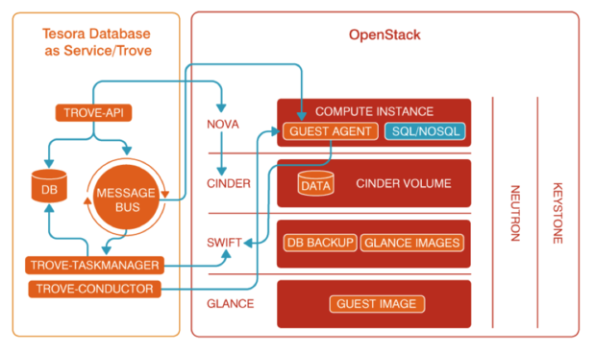
Trove – Database
The Database service provides resource isolation at high performance levels, and automates complex administrative tasks such as deployment, configuration, patching, backups, restores, and monitoring.

Slide 5
Trove – Database
Installation:
Follow https://docs.openstack.org/project-install-guide/database/ocata/install-ubuntu.html
Main steps are:
(1) Create the database trove.
(2) Create the Database service API endpoints.
(3) Install the packages python-trove, python-troveclient, python-glanceclient, trove-common, trove-api trove-taskmanager, trove-conductor.
(4) In the /etc/trove directory, edit the trove.conf, trove-taskmanager.conf and trove-conductor.conf, trove-guestagent.conf.
(5) In the /etc/init directory, edit the trove-taskmanager.conf and trove-conductor.conf.

Slide 6
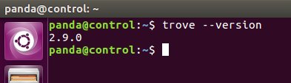
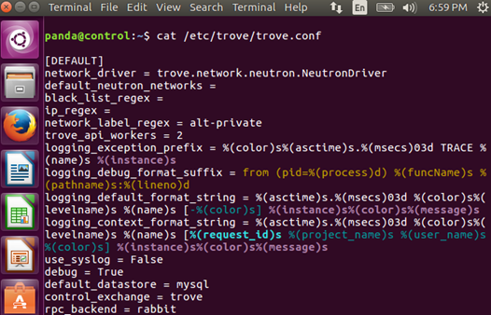
Trove – Database
Result

Slide 7
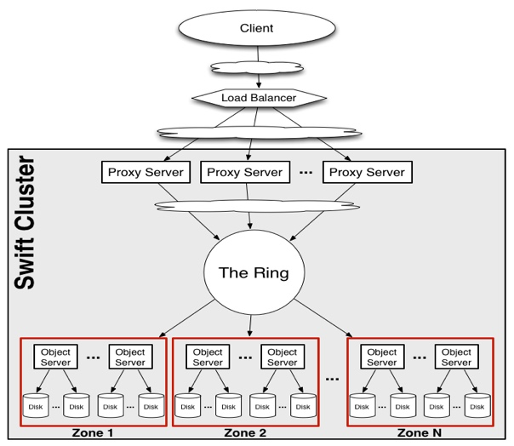
Swift - Object Store
The OpenStack Object Storage is a multi-tenant object storage system.
It is highly scalable and can manage large amounts of unstructured data at low cost through a RESTful HTTP API.

Slide 8
Swift - Object Store
Installation:
Follow https://docs.openstack.org/project-install-guide/object-storage/ocata/controller-install-ubuntu.html
Main steps are:
(1) Configure network.
(2) Create the Identity service credentials.
(3) Create the Object Storage service API endpoints.
(4) Install the packages swift, swift-proxy python-swiftclient, python-keystoneclient, python-keystonemiddleware, memcached.
(5) Create the /etc/swift directory and edit the /etc/swift/proxy-server.conf.
(6) Configure storage node .

Slide 9

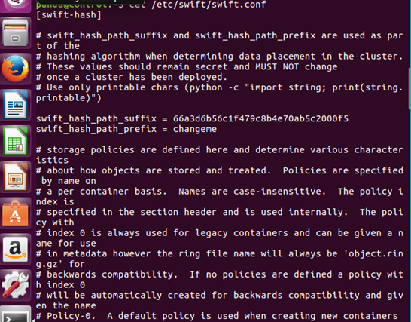
Swift - Object Store
Result

Slide 10
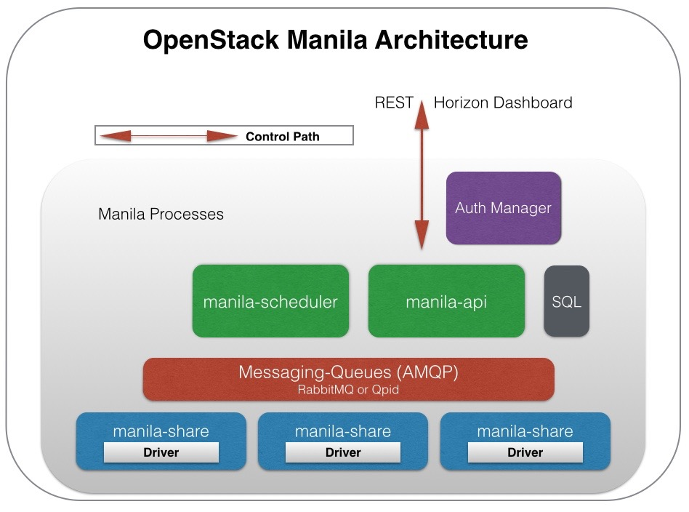
Manila - Shared File System
The Shared File Systems service (manila) provides coordinated access to shared or distributed file systems.

Slide 11
Manila - Shared File System
Installation:
Follow https://docs.openstack.org/project-install-guide/shared-file-systems/ocata/
Main steps are:
(1) Create the manila database.
(2) Create the service credentials.
(3) Create the Shared File Systems service API endpoints.
(4) Install the packages manila-api, manila-scheduler, python-manilaclient.
(5) Edit the /etc/manila/manila.conf file.
(6) Configure share node.

Slide 12

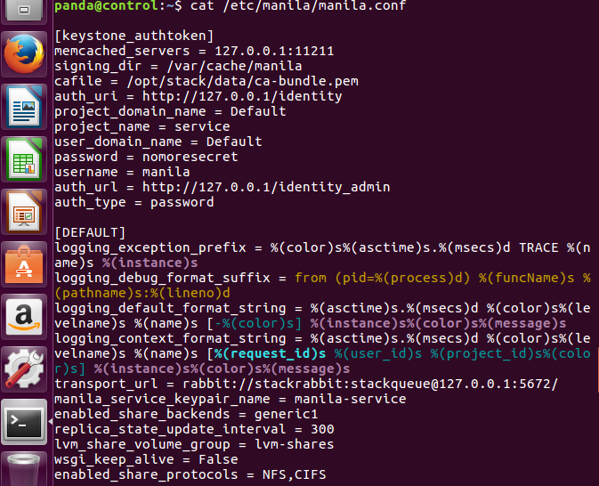
Manila - Shared File System
Result

Slide 13
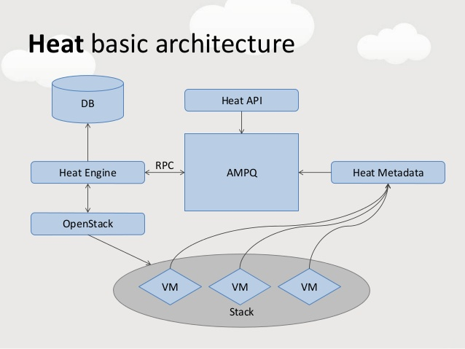
Heat - Orchestration
The Orchestration service provides a template-based orchestration for describing a cloud application by running OpenStack API calls to generate running cloud applications.

Slide 14
Heat - Orchestration
Installation:
Follow https://docs.openstack.org/project-install-guide/orchestration/ocata/install-ubuntu.html
Main steps are:
(1) Create the heat database.
(2) Create the service credentials.
(3) Create the Orchestration service API endpoints.
(4) Install the packages heat-api, heat-api-cfn, heat-engine.
(5) Edit the /etc/heat/heat.conf.

Slide 15

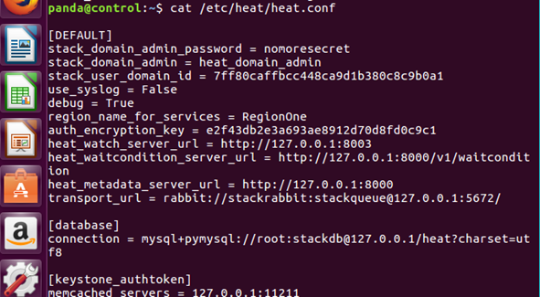
Heat - Orchestration
Result

Slide 16
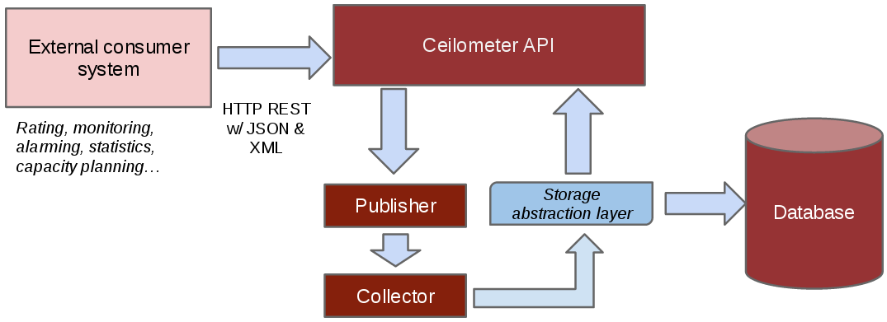
Ceilometer - Telemetry
The Telemetry Data Collection services provide the following functions:
Efficiently polls metering data related to OpenStack services.
Collects event and metering data by monitoring notifications sent from services.
Publishes collected data to various targets including data stores and message queues.

Slide 17
Ceilometer - Telemetry
Installation:
Follow https://docs.openstack.org/project-install-guide/telemetry/ocata/install-base-ubuntu.html
Main steps are:
(1) Create the service credentials.
(2) Register Gnocchi service in Keystone.
(3) Edit the /etc/ceilometer/ceilometer.conf.
(4) Edit the /etc/gnocchi/gnocchi.conf.
(5) Create Ceilometer resources in Gnocchi.

Slide 18
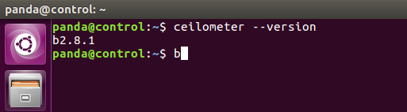
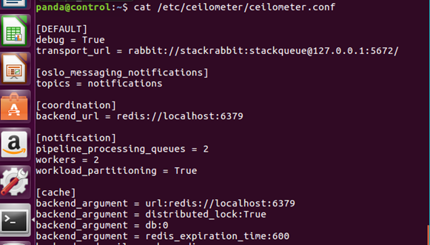
Ceilometer - Telemetry
Result

Slide 19
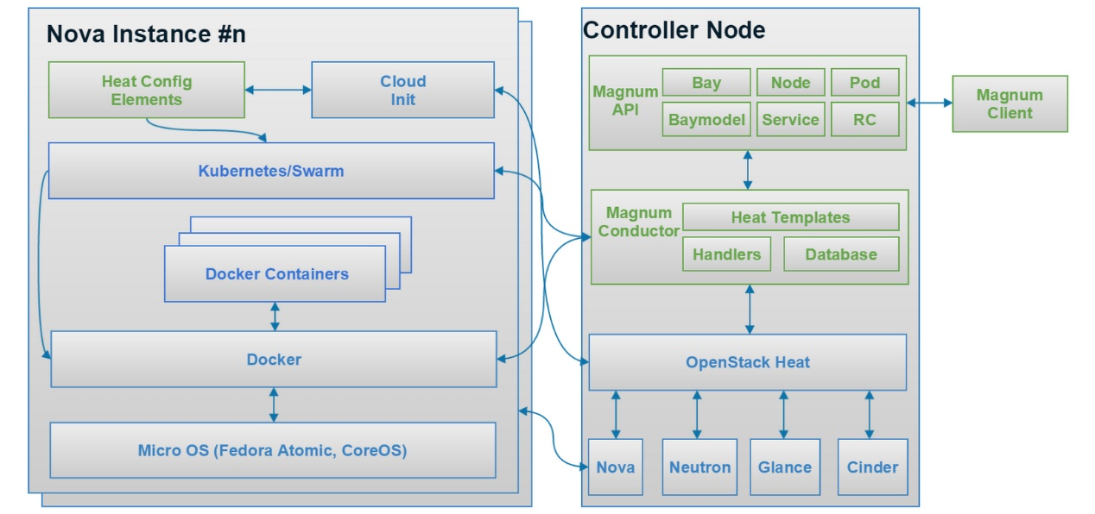
Magnum - Container Service
Magnum uses Heat to orchestrate an OS image which contains Docker and Kubernetes and runs that image in either virtual machines or bare metal in a cluster configuration.

Slide 20
Magnum - Container Service
Installation:
Follow https://docs.openstack.org/project-install-guide/container-infrastructure-management/ocata/install-ubuntu.html
Main steps are:
(1) Create the magnum database.
(2) Create the service credentials.
(3) Create the Container Infrastructure Management service API endpoints.
(4) Install packages magnum-api, magnum-conductor, python-magnumclient.
(5) Edit the /etc/magnum/magnum.conf file.

Slide 21

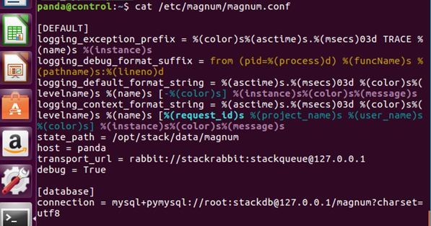
Magnum - Container Service
Result

Slide 22
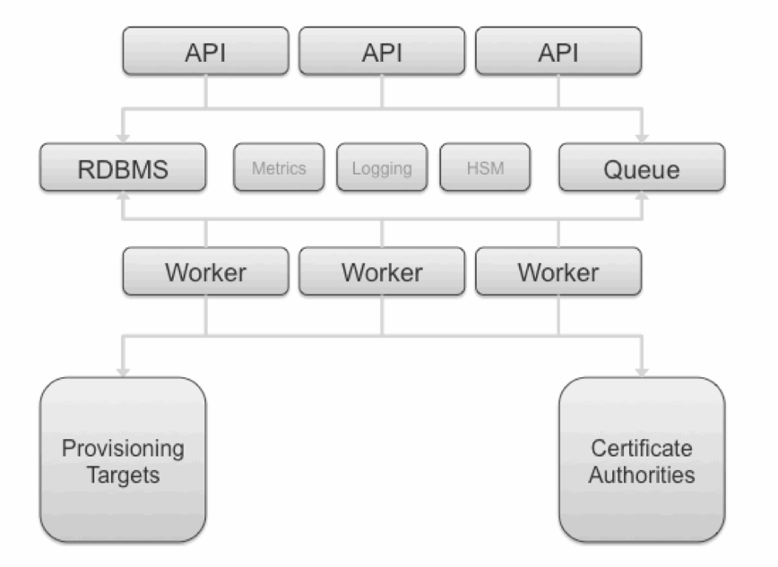
Barbican Key Manager Service
Barbican is a REST API designed for the secure storage, provisioning and management of secrets.
It is aimed at being useful for all environments, including large ephemeral Clouds.

Slide 23
Barbican Key Manager Service
Installation:
Follow https://docs.openstack.org/project-install-guide/key-manager/ocata/install-ubuntu.html
Main steps are:
(1) Create the barbican database.
(2) Create the service credentials.
(3) Create the Key Manager service API endpoints.
(4) Install the packages barbican-api, barbican-keystone-listener, barbican-worker.
(5) Edit the /etc/barbican/barbican.conf and /etc/barbican/barbican-api-paste.ini.

Slide 24
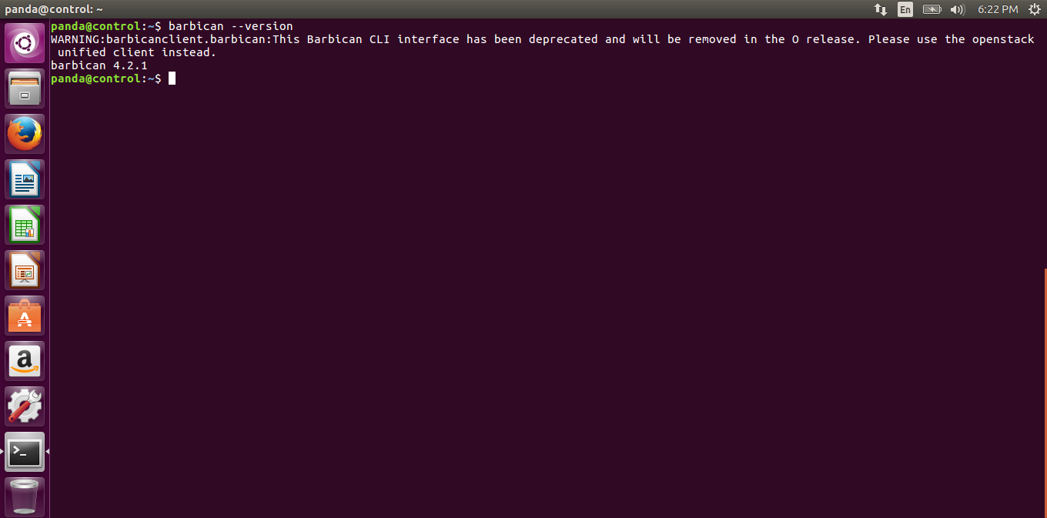
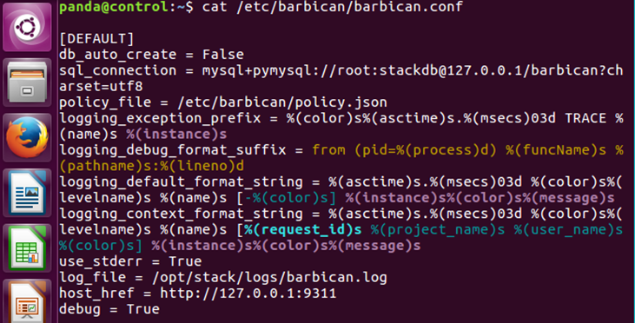
Barbican Key Manager Service
Result

Slide 25
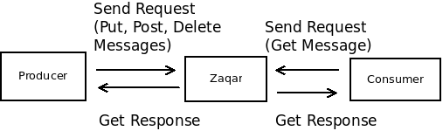
Zaqar Messaging Service
Zaqar is a multi-tenant cloud messaging service for Web developers.
The Message service is multi-tenant, fast, reliable, and scalable.
It allows developers to share data between distributed application components performing different tasks, without losing messages or requiring each component to be always available.

Slide 26
Zaqar Messaging Service
Installation:
Follow https://docs.openstack.org/project-install-guide/messaging/ocata/install-ubuntu.html
Main steps are:
(1) Install and configure MongoDB replica-set on database servers.
(2) Create the service credentials.
(3) Create the Messaging service API endpoints.
(4) Install memcached, Messaging service and uWSGI.
(5) Create log file and edit configuration file.
(6) Create Messaging service’s configuration file /etc/zaqar.conf.

Slide 27
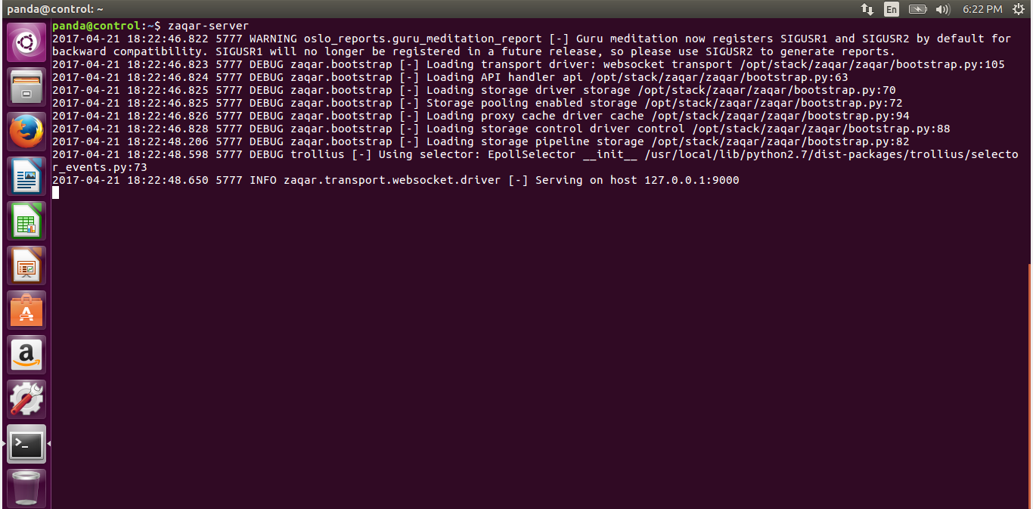
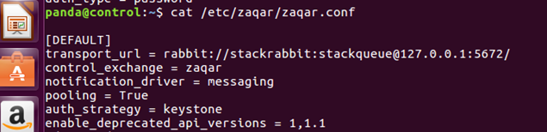
Zaqar Messaging Service
Result

Slide 28
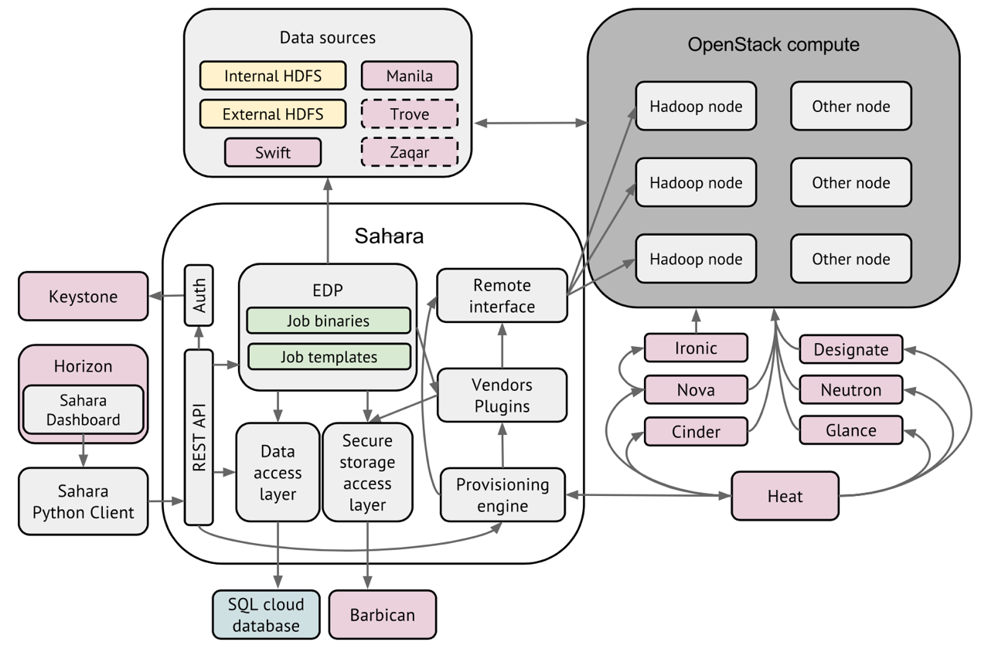
Sahara - Elastic Map Reduce
Sahara aims to provide users with simple means to provision Hadoop clusters.

Slide 29
Sahara - Elastic Map Reduce
Installation:
(1) Install follow: https://docs.openstack.org/developer/sahara/userdoc/installation.guide.html
(2) Configure follow: https://docs.openstack.org/developer/sahara/userdoc/configuration.guide.html

Slide 30
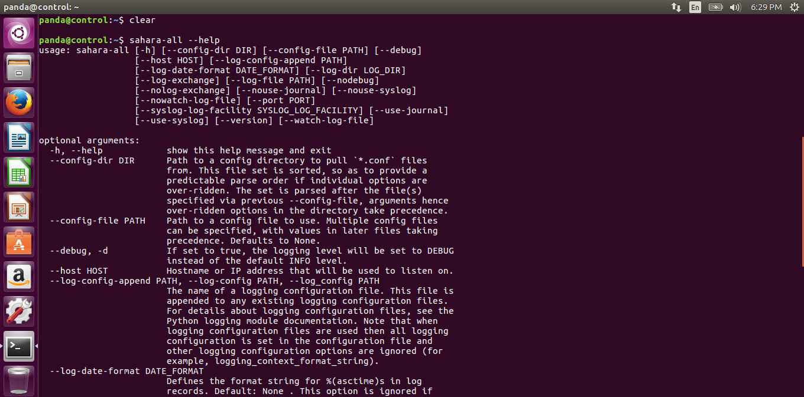
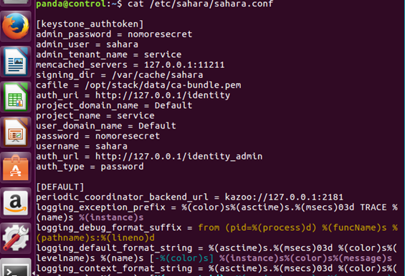
Sahara - Elastic Map Reduce
Result

Slide 31
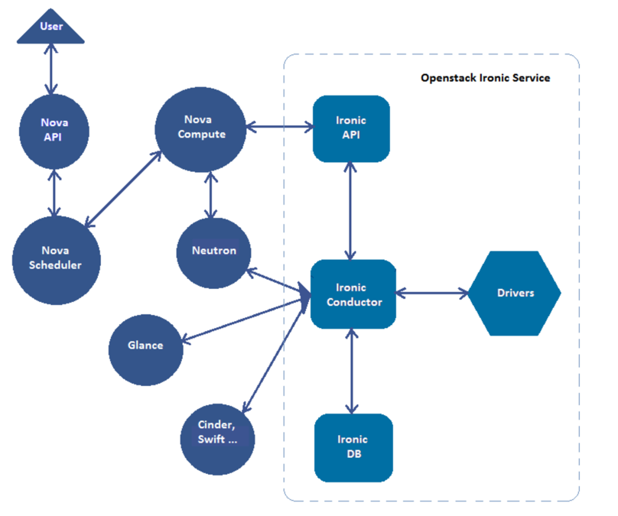
Ironic - Bare-Metal Provisioning
The Bare Metal service is a collection of components that provides support to manage and provision physical machines.

Slide 32
Ironic - Bare-Metal Provisioning
Installation:
Follow https://docs.openstack.org/project-install-guide/baremetal/ocata/install-ubuntu.html
Main steps are:
(1) Create an ironic database.
(2) Install packages ironic-api, ironic-conductor, python-ironicclient.
(3) Edit /etc/ironic/ironic.conf file.
(4) Configuring ironic-conductor service.

Slide 33

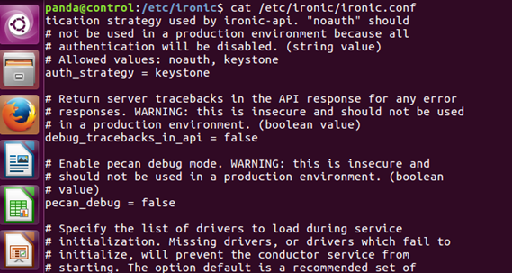
Ironic - Bare-Metal Provisioning
Result

Slide 34
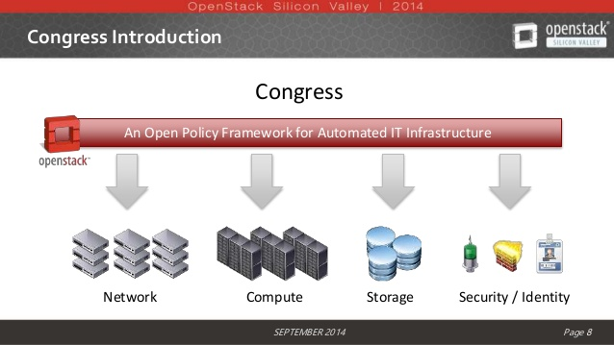
Congress Governance
Congress aims to provide an extensible open-source framework for governance and regulatory compliance across any cloud services within a dynamic infrastructure.

Slide 35
Congress Governance
Installation:
Follow http://congress.readthedocs.io/en/latest/readme.html
Main steps are:
(1) Clone congress and install source code.
(2) Create congress database.
(3) Configure /etc/congress/congress.conf.

Slide 36
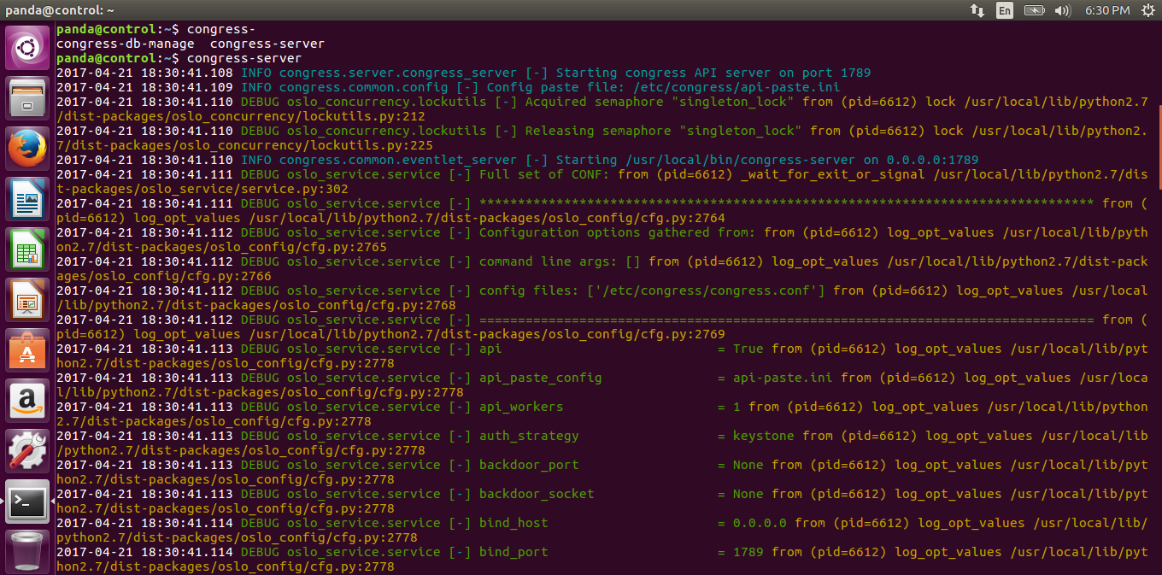
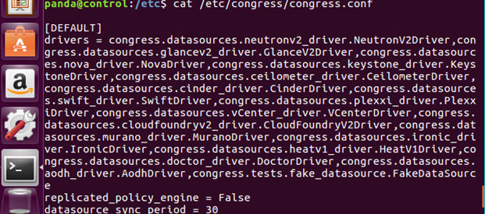
Congress Governance
Result

Slide 37
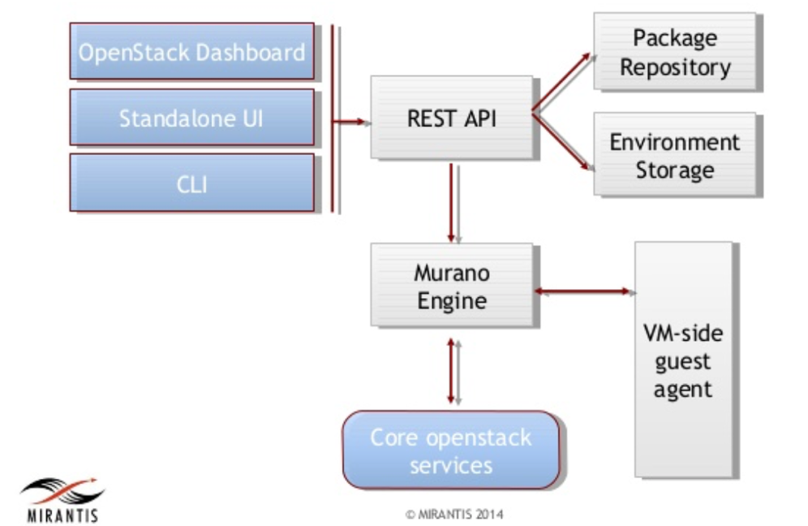
Murano - Application catalog
The Murano Project introduces an application catalog to OpenStack, enabling application developers and cloud administrators to publish various cloud-ready applications in a browsable categorized catalog.

Slide 38
Murano - Application catalog
Installation:
Follow https://docs.openstack.org/developer/murano/administrator-guide/deploy_murano/install_manually.html
Main steps are:
(1) Clone murano and install source code.
(2) Create murano database.
(3) Configure /etc/murano/murano.conf

Slide 39

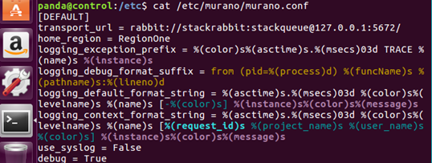
Murano - Application catalog
Result

Slide 40
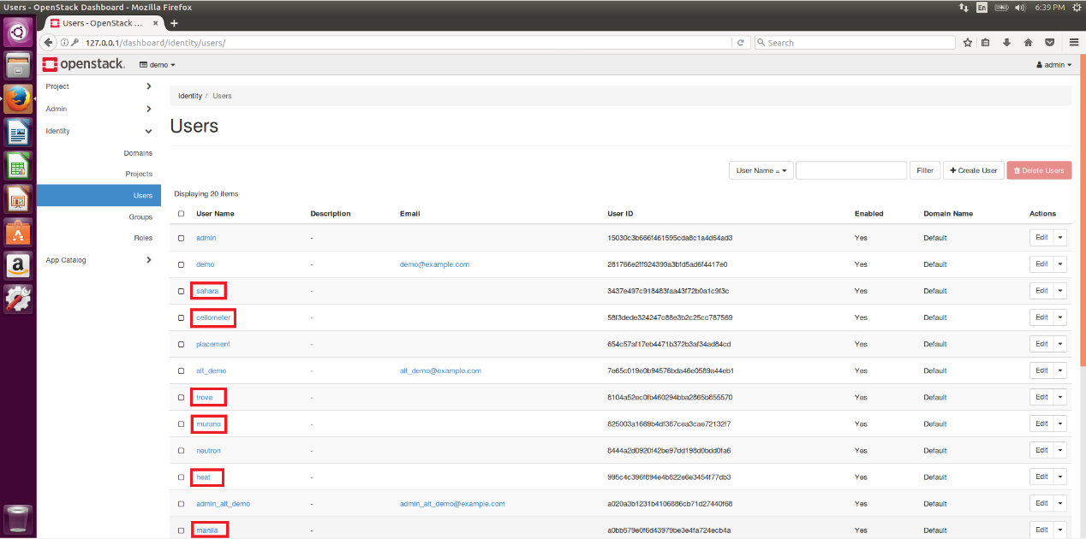
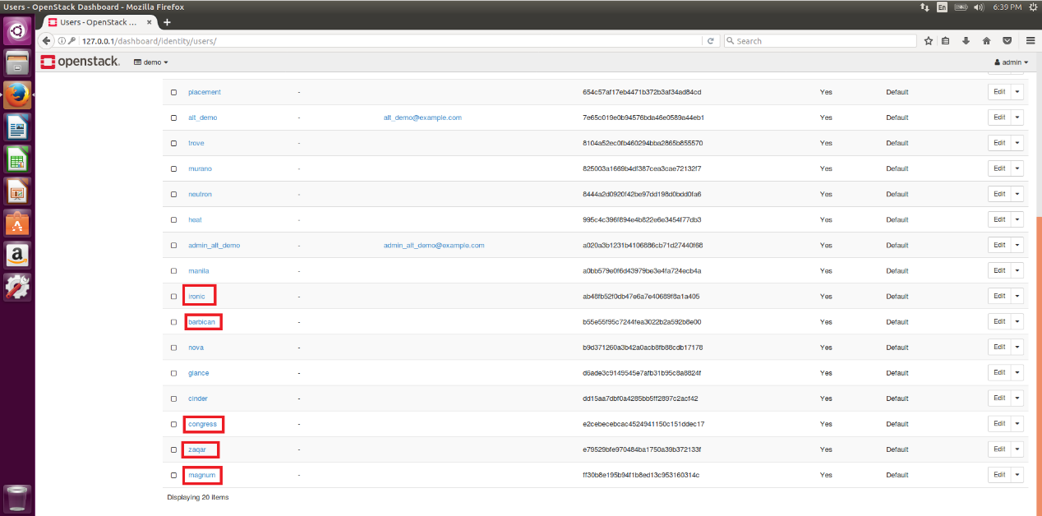
Services shown in Horizon

Slide 41
Conclusion
We have implemented above services of OpenStack on the node of Virtual Machine on Ubuntu 16.04.
During the implementation, we strengthen the knowledge and understanding of cloud computing and the OpenStack system.

Slide 42
References
5 ways OpenStack Trove will change how you manage databases http://www.infoworld.com/article/2881933/database/5-ways-openstack-trove-will-change-how-you-manage-databases.html
Architecture for Barbican. https://docs.openstack.org/developer/barbican/contribute/architecture.html
Architecture for Sahara. https://docs.openstack.org/developer/sahara/architecture.html
Container Infrastructure Management service https://docs.openstack.org/project-install-guide/container-infrastructure-management/newton/
Bare Metal service overview. https://docs.openstack.org/project-install-guide/baremetal/ocata/get_started.html
Configure OpenStack nova with remote Bind Server. http://stackoverflow.com/questions/15779082/configure-openstack-nova-with-remote-bind-server
Database service overview https://docs.openstack.org/project-install-guide/database/newton/get_started.html
Introduction to Ironic. https://docs.openstack.org/developer/ironic/deploy/user-guide.html
Install and configure MongoDB replica-set on database servers:Wikipedia. OpenStack. https://en.wikipedia.org/wiki/OpenStack
Openstack and Docker – Part 2 https://sreeninet.wordpress.com/2015/06/14/openstack-and-docker-part-2/
OpenStack Series: Part 11 Ceilometer – Monitoring and Metering Service http://cloudn1nblogspot.hk/2014/11/openstack-series-part-11-ceilometer.html
OUTREACHY WITH OPENSTACK ZAQAR. http://exploreshaifali.github.io/talks/6-8-2015-outreachy-with-openstack-zaqar.html#/cover-page
Policy in OpenStack - Martin Casado, CTO, VMware - OpenStackSV 2014 https://www.slideshare.net/mirantis/openstack-policy-martin-casado-vmware-keynote-openstacksv
Shared File Systems Installation Tutorial. https://docs.openstack.org/project-install-guide/shared-file-systems/newton/

